Slide 1












Sentence Completion

Slide 2


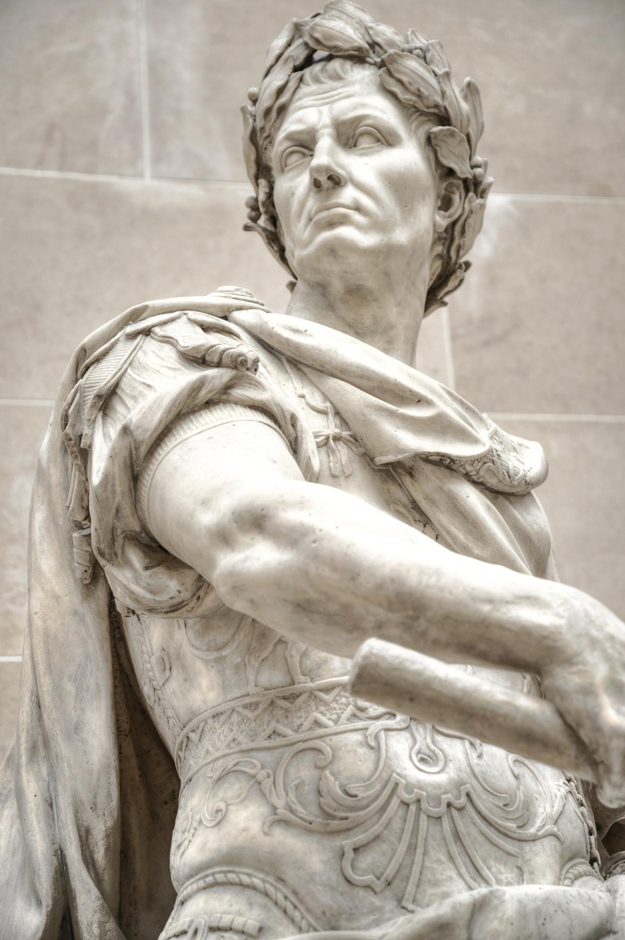

Sentence Completion
A collection of meaningful words that contains a subject, helping verb, a verb, and noun to complete a sentence.
A sentence can be a question or an answer, a wish, expression, or statement.
It involves taking a partial or incomplete sentence and finishing it in a way that is grammatically correct and logically consistent.

Slide 3







Significance of Sentence Completion
Enhances Vocabulary: Completing sentences requires you to use appropriate words.
Improves Grammar: You need to ensure the sentence is grammatically correct.
Develops Logical Thinking: You need to understand the context and follow the logical progression of ideas.
Boosts Writing Skills: By practicing sentence completion, you become better at forming coherent and well-structured sentences, improving your overall writing skills.

Slide 4
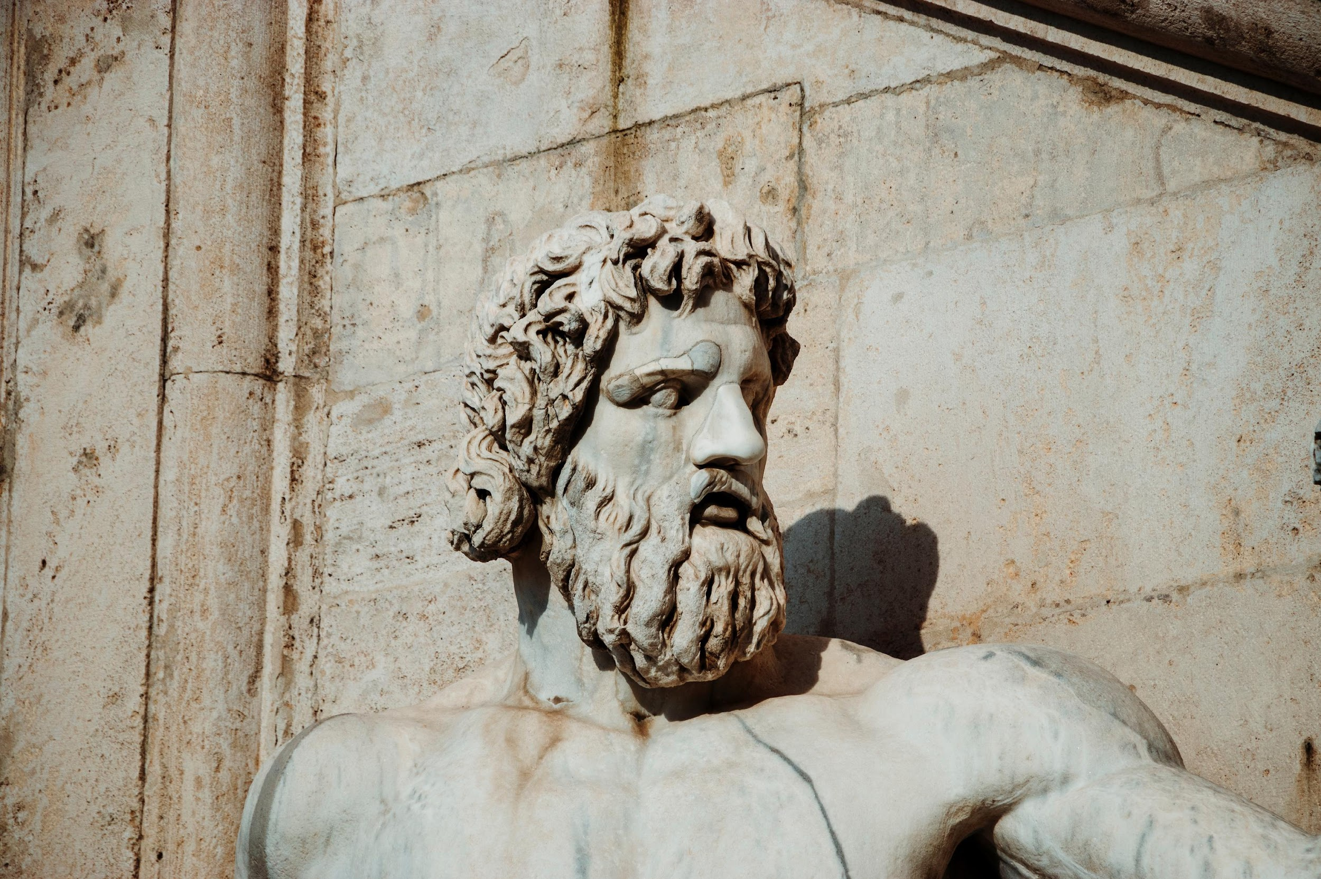

How
to
complete
a
sentence?

Slide 5


Tips for Sentence Completion
Read the Entire Sentence
Come up with Your Own Answer
Identify Signal Words and Phrases
Consider Word Positivity/Negativity
Punctuation
For instance: if “,” is followed by a blank then find the synonym of the word before the “,” and check the options to match the synonym of the word.
Trying to guess what words could go in the blanks before you try to understand the question as a whole, you’ll be acting on incomplete information and you could easily get confused.
Consider what word(s) you would put in the blank(s). This can help you eliminate answer choices that are obviously incompatible and point towards answer choices that are similar to what you would put in the blanks.
Signal words, commonly transitions, indicate the overall structure of ideas in a sentence, and thus can help point you towards the correct answer.
If the flow of the first part of the sentence is positive and the second part is negative, then the blank must be negative to even the flow of the sentence.

Slide 6
Tips for Sentence Completion
Use Process of Elimination
Read through the sentence/question once you’ve chosen the answer
Learning Vocabulary
If you need to guess, always use process of elimination first. You can combine this with the strategies above (like word positivity/negativity and considering what you would put in the blank) to help you eliminate wrong answers..
To improve your vocabulary, focus on two things: memorizing words and learning them in context.
Once you’ve selected words for all of the blanks, make a quick pass through the sentence/question again to make sure everything makes sense.

Slide 7
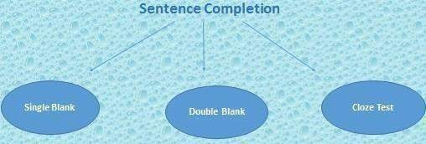
Types of Questions for sentence completion

Slide 8

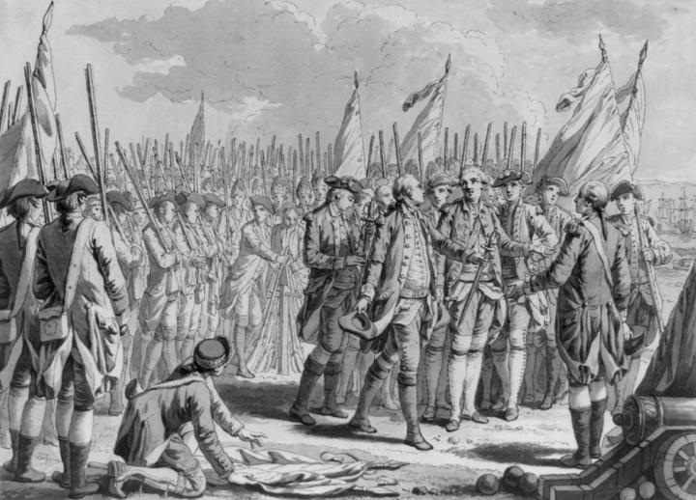
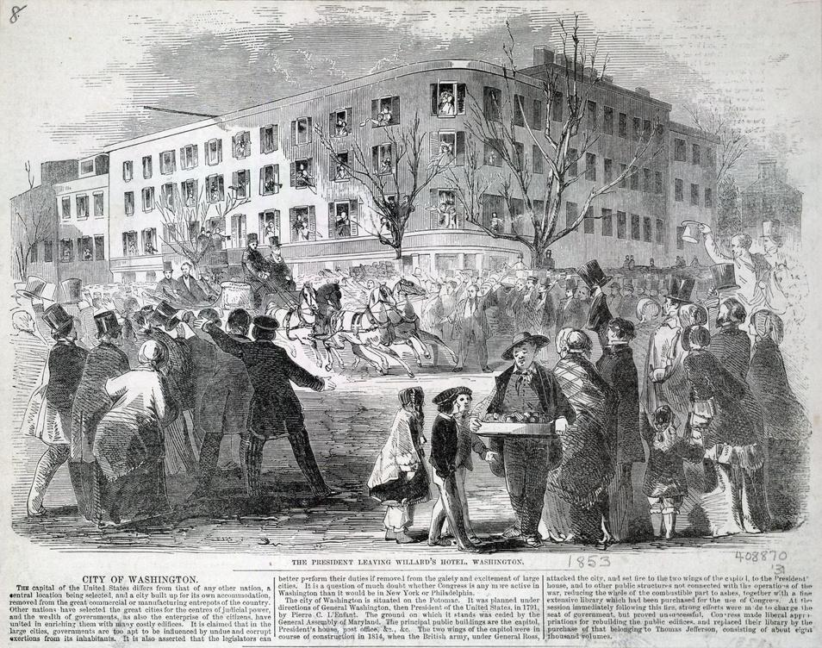
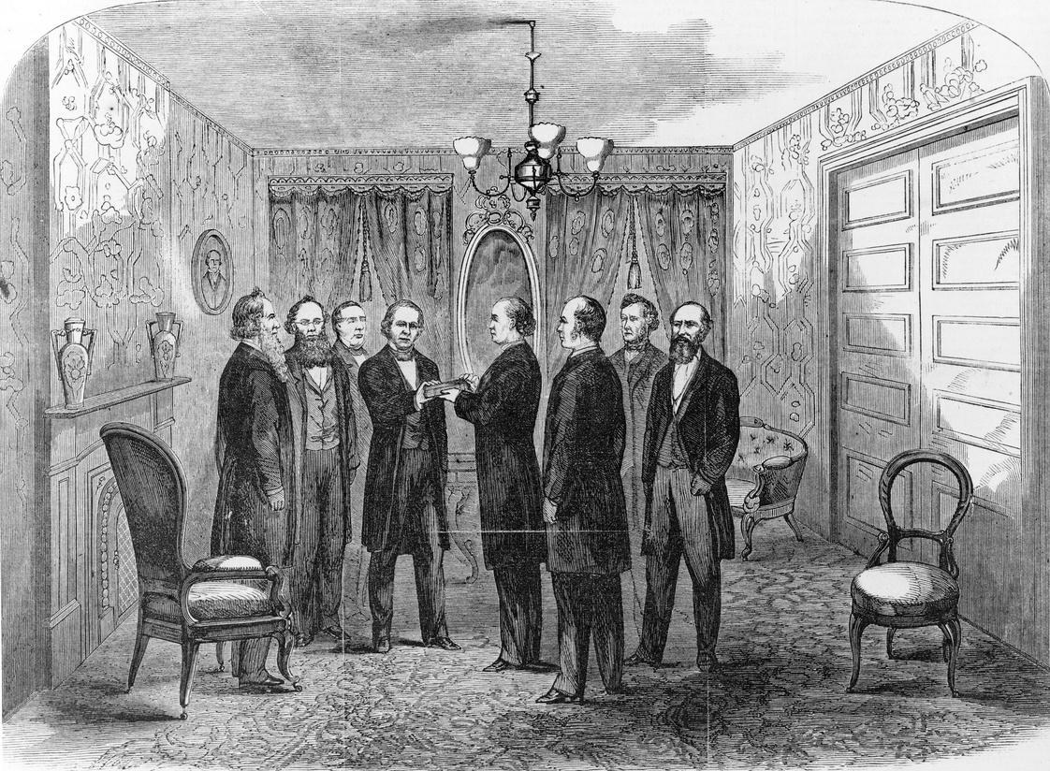
__________
__________ and __________
__________ or __________or __________ or __________
Single Blank
Double Blank
Cloze Test
In single blank sentence completion questions, the sentence has one blank space that needs to be filled with the most appropriate word from the given options.
Double blank sentence completion questions have two blank spaces in a sentence, and the test-taker must select a pair of words from the given options that best complete the sentence meaningfully and grammatically.
A cloze test consists of a passage with several words removed, typically at regular intervals, which the test-taker must fill in. This type of test evaluates the ability to understand the context and overall meaning of the passage.

Slide 9
__________
__________ and __________
__________ or __________or __________ or __________
Single Blank
Double Blank
Cloze Test
The scientist’s groundbreaking discovery was __________ by the scientific community.
ignored
rejected
celebrated
overlooked
The manager’s __________ attitude and the team’s __________ efforts resulted in a successful project.
positive – cooperative
negative – diligent
indifferent – sporadic
enthusiastic - lackluster
Technological advancements have __________ the way we live and work. The __________ of smartphones, for instance, has made communication more __________ and instant. However, these changes also bring about __________, such as data privacy concerns.
a) hindered, disappearance, complicated, benefits
b) transformed, invention, convenient, challenges
c) unchanged, decline, expensive, advantages
d) reverted, removal, obscure, ease

Slide 10
__________
__________ and __________
__________ or __________or __________ or __________
Single Blank
Double Blank
Cloze Test
The scientist’s groundbreaking discovery was __________ by the scientific community.
ignored
rejected
celebrated
overlooked
The manager’s __________ attitude and the team’s __________ efforts resulted in a successful project.
positive – cooperative
negative – diligent
indifferent – sporadic
enthusiastic - lackluster
Technological advancements have __________ the way we live and work. The __________ of smartphones, for instance, has made communication more __________ and instant. However, these changes also bring about __________, such as data privacy concerns.
a) hindered, disappearance, complicated, benefits
b) transformed, invention, convenient, challenges
c) unchanged, decline, expensive, advantages
d) reverted, removal, obscure, ease

Slide 11
Eliminating options using verbal hints
What are Verbal Hints?
Verbal hints are clues embedded within a sentence or passage that help the reader determine the correct word or phrase to complete a sentence.
These hints can come in various forms, such as context clues, synonyms, antonyms, and logical connectors.
Verbal hints guide the reader to understand the intended meaning of the sentence and choose the most appropriate option for the blank.

Slide 12
How Verbal Hints Aid in Sentence Completion
Contextual information that helps the reader understand the overall meaning of the sentence.
Providing Context
Indicating whether the words should be similar, opposite, or logically connected.
Clarifying Relationships
Making connections between different parts of the text lead to a more coherent understanding.
Enhancing Comprehension
Eliminating choices that do not fit the context or logical flow of the sentence.
Eliminating Incorrect Options

Slide 13
Types of Verbal Hints
Contextual Clues
Logical Connections
Examples and Explanations
Punctuation and Grammar
Synonyms and Antonyms

Slide 14
Contextual Clues
These are words or phrases within the sentence that provide information about the missing word.
For example: "The weather was so ___ that we decided to stay indoors.“
The word "indoors" suggests that the missing word describes unpleasant weather, such as "bad" or "stormy."

Slide 15
Synonyms and Antonyms
Synonyms are words with similar meanings, while antonyms are words with opposite meanings.
For instance: "She was known for her generosity and ___," the word "generosity" suggests a synonym such as "kindness" or "benevolence.“
Conversely, in the sentence, "Unlike his shy brother, John was very ___," the word "shy" suggests an antonym like "outgoing" or "confident."

Slide 16
Logical Connections
These include words or phrases that establish logical relationships, such as cause and effect, contrast, or comparison.
Examples include "however," "therefore," "because," and "although."
For instance: "She studied hard; therefore, she ___ the exam," the word "therefore" indicates a logical result, suggesting a word like "passed" or "aced."

Slide 17
Punctuation and Grammar
Sometimes, punctuation marks and grammatical structures can serve as hints.
For example, colons, semicolons, and conjunctions can indicate a list, a cause-and-effect relationship, or a contrast.

Slide 18
Examples and Explanations
Sentences often contain examples or explanations that clarify the meaning of the missing word.
For example, "He was an erudite scholar, always quoting ancient texts and engaging in intellectual debates."
“Erudite" is suggested by the examples of quoting texts and engaging in debates.

Slide 19
Try to use Elimination Technique TO COMPLETE THE SENTENCE
The politician's speech was filled with ___, making it difficult to discern his true stance on the issues.
A) clarity
B) vagueness
C) precision
D) transparency

Slide 20
The phrase "making it difficult to discern his true stance" indicates that the speech lacked clarity.
"Vagueness" fits best as it implies a lack of clear, precise information.

Slide 21
SO, THE CORRECT ANSWER IS…
The politician's speech was filled with ___, making it difficult to discern his true stance on the issues.
A) clarity
B) vagueness
C) precision
D) transparency

Slide 22
Try to use Elimination Technique TO COMPLETE THE SENTENCE
Despite his ___ demeanor, he was known for his ___ generosity.
A) gruff / immense
B) cheerful / minimal
C) stern / meager
D) friendly / limited

Slide 23
The word "despite" indicates a contrast.
"Gruff" (rough or stern) contrasts with "immense" (great or large) generosity, showing that despite his rough exterior, he is very generous.

Slide 24
SO, THE CORRECT ANSWER IS…
Despite his ___ demeanor, he was known for his ___ generosity.
A) gruff / immense
B) cheerful / minimal
C) stern / meager
D) friendly / limited

Slide 25
Try to use Elimination Technique TO COMPLETE THE SENTENCE
Technological advancements have __________ the way we live and work. The __________ of smart phones, for instance, has made communication more __________ and instant. However, these changes also bring about __________, such as data privacy concerns.
a) hindered, disappearance, complicated, benefits
b) transformed, invention, convenient, challenges
c) unchanged, decline, expensive, advantages
d) reverted, removal, obscure, ease

Slide 26
"Technological advancements have transformed the way we live and work" –
"Transformed" means significantly changed.
"The invention of smart phones" - "Invention" refers to the creation of new technology. "has made communication more convenient and instant"
"Convenient" fits with the idea of easier communication. "However, these changes also bring about challenges" - "Challenges" are the difficulties that arise, like data privacy concerns.

Slide 27
SO, THE CORRECT ANSWER IS…
Technological advancements have __________ the way we live and work. The __________ of smart phones, for instance, has made communication more __________ and instant. However, these changes also bring about __________, such as data privacy concerns.
a) hindered, disappearance, complicated, benefits
b) transformed, invention, convenient, challenges
c) unchanged, decline, expensive, advantages
d) reverted, removal, obscure, ease

Slide 28
Try to use Elimination Technique TO COMPLETE THE SENTENCE
The scientist's theory was initially met with ___, but over time it gained ___ among his peers.
A) skepticism / acceptance
B) enthusiasm / rejection
C) indifference / criticism
D) support / doubt

Slide 29
The phrase "initially met with"
followed by a contrasting outcome "over time it gained"
indicates a shift from doubt to approval.
"Skepticism" to "acceptance" fits this narrative.

Slide 30
SO, THE CORRECT ANSWER IS…
The scientist's theory was initially met with ___, but over time it gained ___ among his peers.
A) skepticism / acceptance
B) enthusiasm / rejection
C) indifference / criticism
D) support / doubt

Slide 31
Connectors and Signal words
Some signal words connect the parts of the sentence. These signal words are called "indicators".
Indicators for Cause and Effect
Indicators for Contrast
Indicators for Similarity
Indicators for Restatement

Slide 32
Indicators for Cause and Effect
Rizwana always wins the debate competition because she works _____ to prepare the topic.
a) lazily
b) hard
c) continually
d) spontaneously

Slide 33
Indicators for Cause and Effect
Rizwana always wins the debate competition because she works _____ to prepare the topic.
a) lazily
b) hard
c) continually
d) spontaneously

Slide 34
Indicators for Cause and Effect
The team worked tirelessly ___________ they could meet the deadline.
A) while
B) therefore
C) unless
D) so that

Slide 35
Indicators for Cause and Effect
The team worked tirelessly ___________ they could meet the deadline.
A) while
B) in order to
C) unless
D) so that

Slide 36
Indicators for Cause and Effect
He invested in stocks ___________ he wanted to increase his wealth.
A) even though
B) because
C) however
D) unless

Slide 37
Indicators for Cause and Effect
He invested in stocks ___________ he wanted to increase his wealth.
A) even though
B) because
C) however
D) unless

Slide 38
Indicators for Cause and Effect
The new employee was struggling, ___ the manager provided additional training, ___ improving their performance.
A. hence, accordingly
B. thus, consequently
C. consequently, therefore
D. therefore, hence

Slide 39
Indicators for Cause and Effect
The new employee was struggling, ___ the manager provided additional training, ___ improving their performance.
hence, accordingly
thus, consequently
consequently, therefore
therefore, hence

Slide 40
Indicators for Cause and Effect
The researcher's hypothesis was correct, ___ the data supported their theory, ___ the research was published in a prestigious journal, ___ receiving international recognition.
therefore, hence, thus
hence, thus, consequently
thus, consequently, therefore
consequently, hence, therefore

Slide 41
Indicators for Cause and Effect
The researcher's hypothesis was correct, ___ the data supported their theory, ___ the research was published in a prestigious journal, ___ receiving international recognition.
therefore, hence, thus
hence, thus, consequently
thus, consequently, therefore
consequently, hence, therefore

Slide 42
Other Indicators for Cause and Effect can be…
so
so that
causes
accordingly
thus
consequently
hence
therefore
in order to

Slide 43
Any Doubt?

Slide 44
Thank
you

